Slide 1
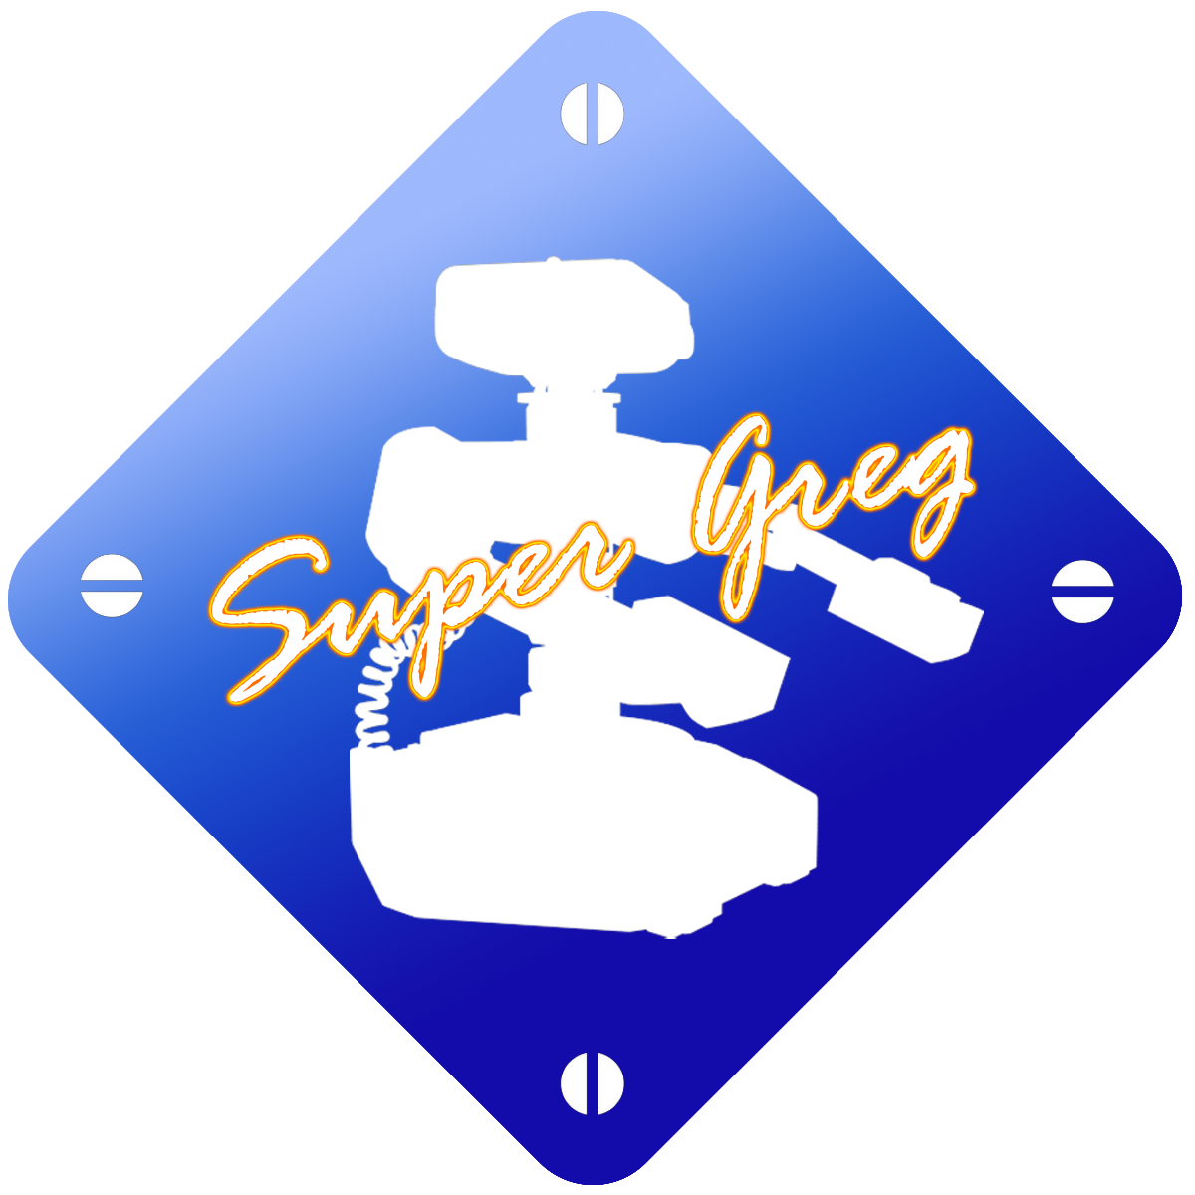
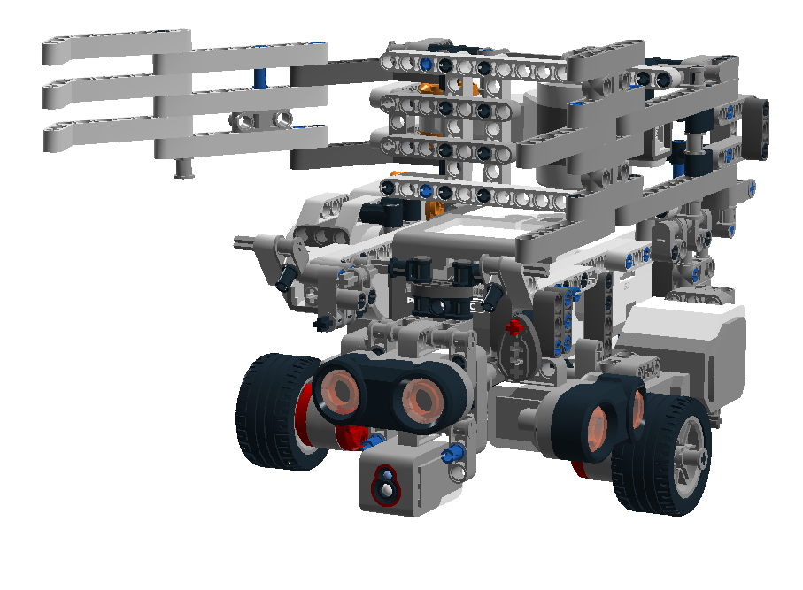
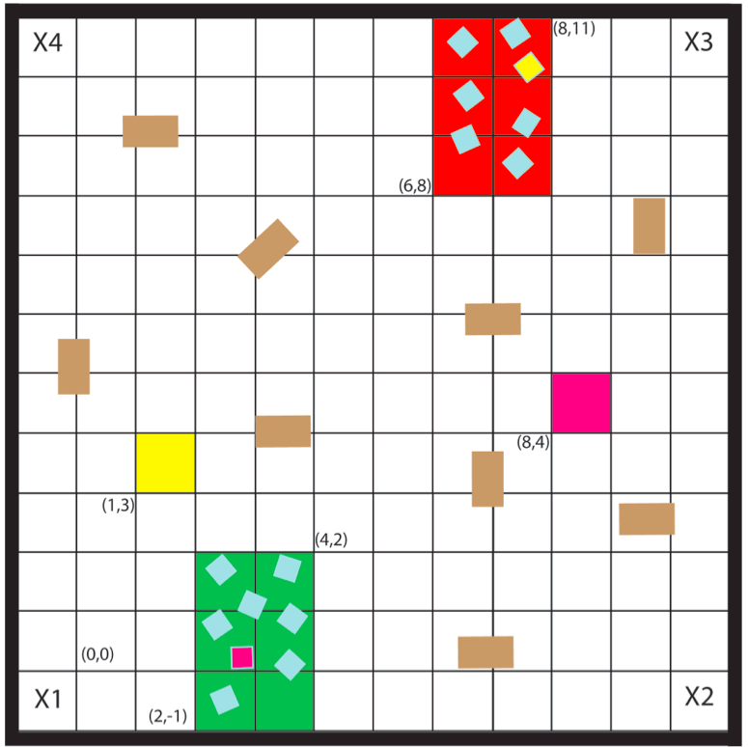
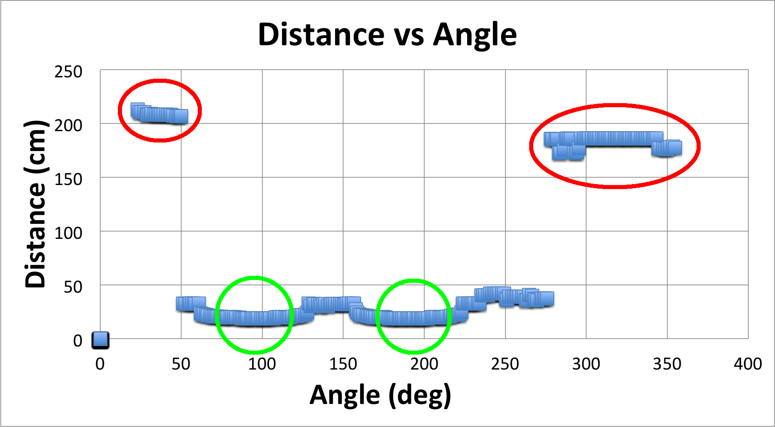
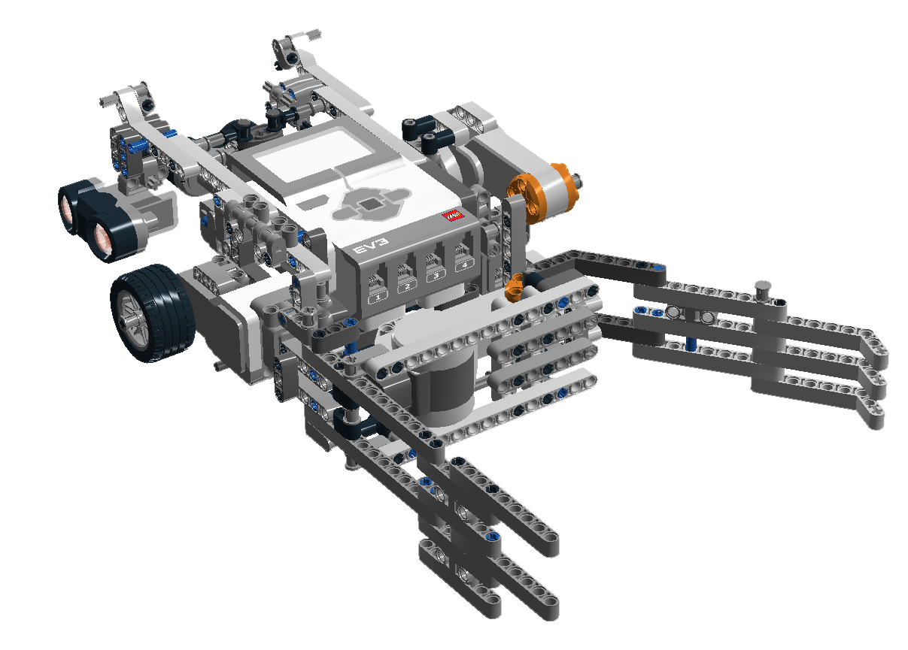
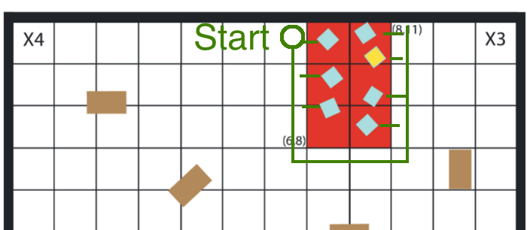
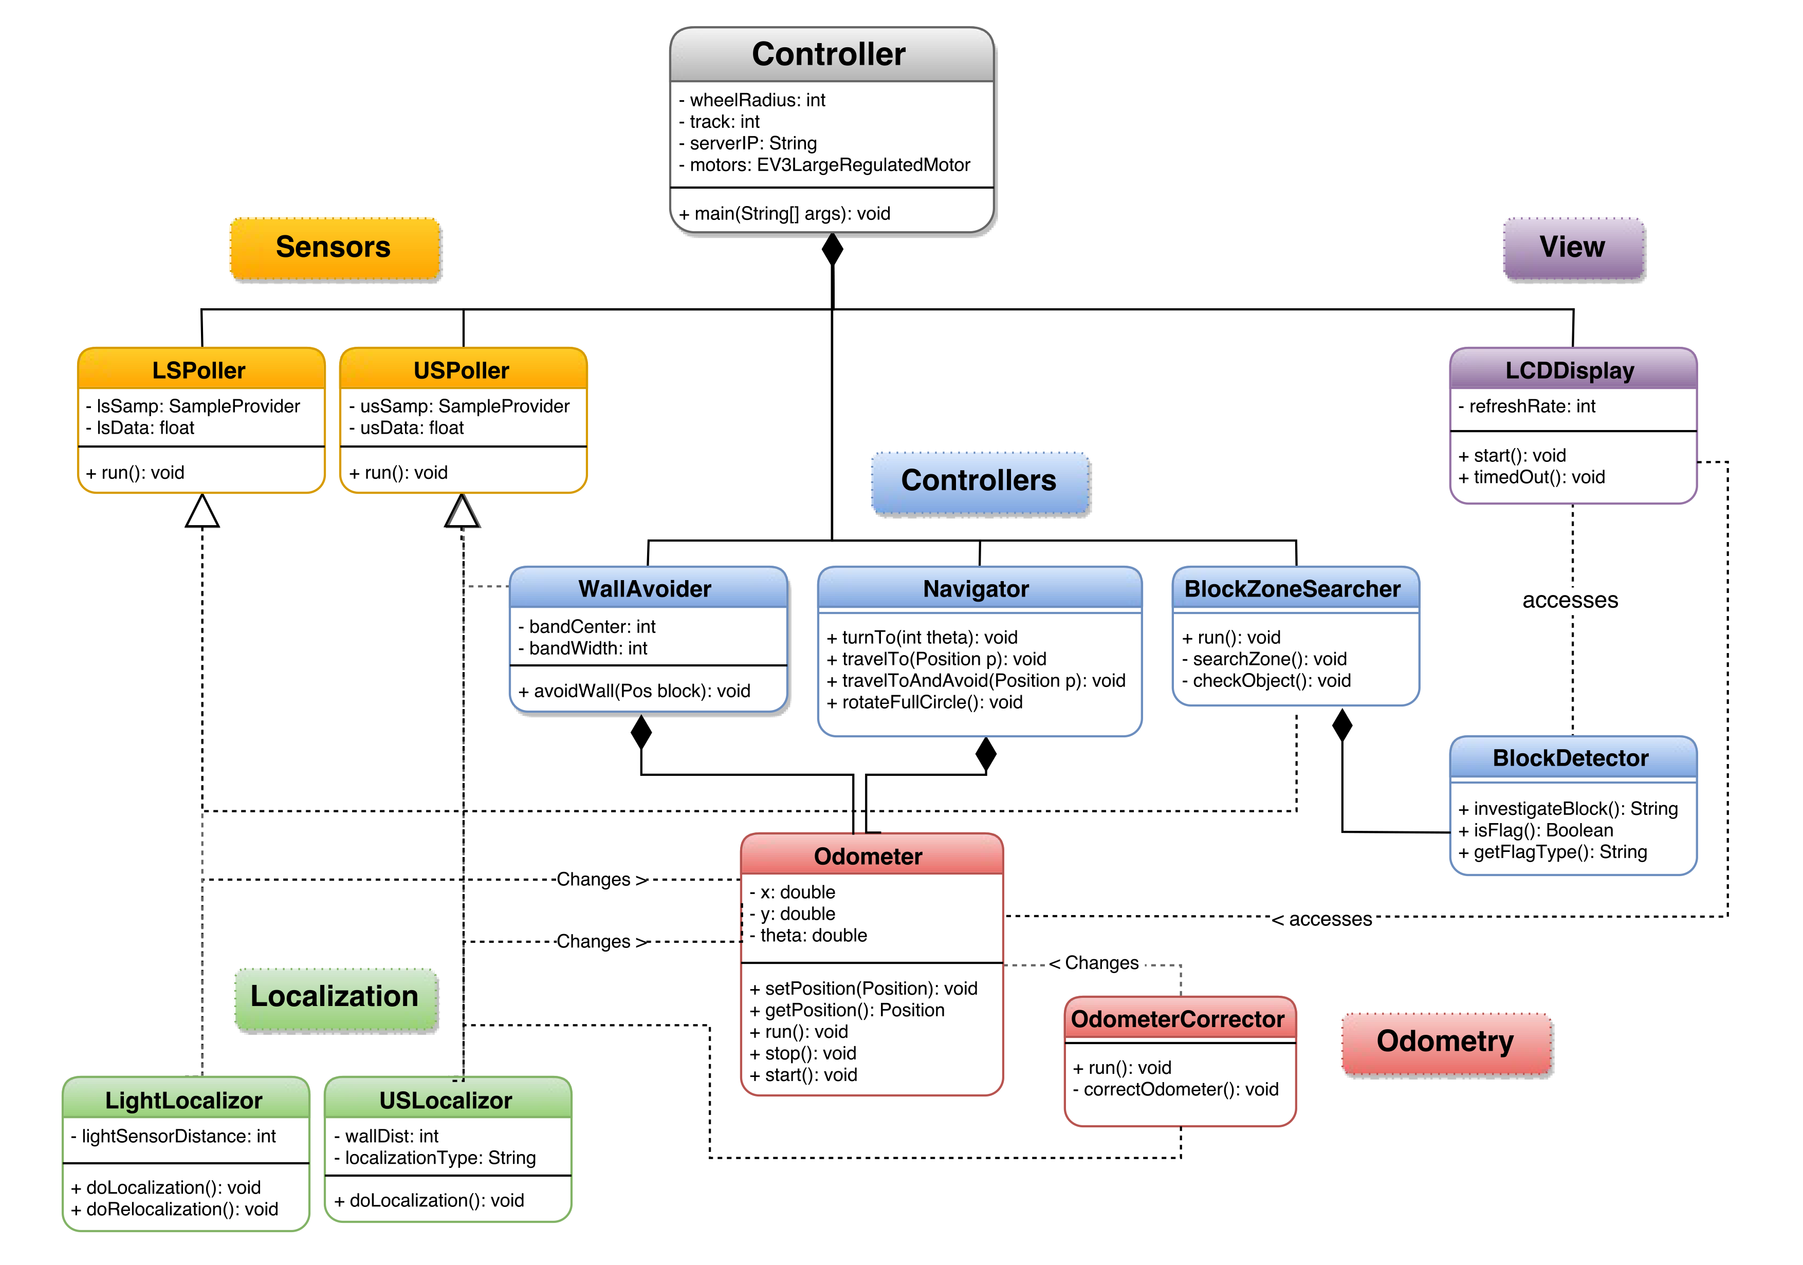




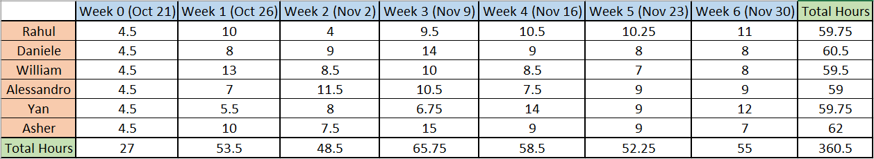

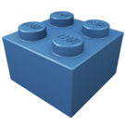
GREG, the Flag Capturing Robot
Amlekar, Rahul
Bouchard, William
Bercovici, Daniele
Commodari, Alessandro
Ren, Yan
Wright, Asher
| Project Manager
| Hardware Manager
| Software Engineer
| Documentation Manager
| Software Engineer
| Software Manager
TEAM 14
ECSE 211: DESIGN PRINCIPLES & METHODS
Objective
Hardware Design
Strategy
SOFTWARE ARCHITECTURE
The objective of the project is to construct an autonomous robot that navigates to its opponents specified area in search for a specific colored block. It must then capture this block and return to its start position before the opposing robot does the same.
Localization (figuring out initial position):
We chose to localize by looking at the distance values 360-degrees around the robot, and then figuring out the initial orientation.
A typical distance profile looks something like this:
The ultrasonic sensors are 90-degrees from each other. One faces the left and is used to drive around blocks, and search for the flag. The other faces forward, and ensures that the robot doesn’t crash into any blocks.
The color sensor (below the front US sensor) is used to detect the flag.
The arena is a 12’x12’ enclosed area filled with randomly placed obstacles (brown blocks). Each robot has a zone to travel to (red and green zones), and each zone contains potential flags (blue, yellow, and pink squares).
The green circles (minima) correspond to the two walls. The red circles correspond to the arena. The robot then knows where it is.
Navigation & Odometry:
As the robot navigates towards a position, it updates its odometer by keeping track of how much its wheels spin. It also corrects the odometer whenever it hits a black grid line.
Avoidance:
Upon seeing a block in the way, the robot rotates to use the side-sensor to “watch” the block. The robot then passes the block and continues.
Constraints
The pick-up mechanism drops down behind the robot to grab the flag. The flag is then lifted on top of the robot. This removes any friction from the flag, and keeps a consistent center of mass.
The EV3 brick’s buttons are easily accessible, which makes it much quicker to test different software.
Searching for the block:
The robot travels around the perimeter of the flag zone while using the side-sensor to search for blocks. It checks to see if each block is the flag.
There were many constraints on the project. These included:
Time constraints
The robot has to localize (determine its initial position) in under 30 seconds
The robot has to capture the flag in under 5 minutes
The total project time (budget) allowed was 9 hours/week for each person, for a total of 7 weeks
2. Hardware Constraints
We constrained our hardware design by choosing to only use one EV3 brick. This meant that our design could only use four sensors, and four motors.
The only sensors we were allowed to use were ultrasonic sensors, light sensors, touch sensors, and gyro sensors.
The robot was not allowed to use sensors to intentionally interfere with those of the opponent robot.
Software Design
Platforms Used
1. Slack
Slack (team messaging platform) was used for messaging (text and media) between the teams and sub-teams.
2. Dropbox
Dropbox is a cloud storage service. We used Dropbox to store all of our documentation, meeting minutes, and presentations. We also used Dropbox to simultaneously collaborate on documents.
Budget
3. Gantt Project
Gantt Project is used for creating Gantt models. It was used to keep track of the project, and ensure everything was on track.
Our team went slightly over-budget on the allowed time. However, the time spent by team members was very similar. Additionally, much of this time was spent at meetings. These meetings included weekly meetings with the professor, TA, and with just the group.
4. GitHub
GitHub (Web-based software hosting platform) was used for the robot’s software. This simplified software collaboration, and allowed everyone to make changes at any time.
5. Eclipse
Eclipse (Java IDE) was the IDE we used for coding (with Git). It allowed for simple integration with Git and the Lejos EV3.
The software is split into Sensors, Localization, Odometry, Controllers, and View (LCD).
We minimized the amount of classes we used to keep the code as readable as possible.
Our code followed the open-close principle: open for addition, closed for modification.
6. Lego Digital Designer
Lego Digital Designer (Lego modelling software) was used to model the hardware designs of the robot.

